Slide 1
localStorage
Web Development 1
John Rellis

Slide 2

What is localStorage?
The localStorage read-only property of the window interface allows you to access a Storage object for the Document's origin; the stored data is saved across browser sessions.
localStorage data for a document loaded in a "private browsing" or "incognito" session is cleared when the last "private" tab is closed
https://developer.mozilla.org/en-US/docs/Web/API/Window/localStorage

Slide 3
Storage?
https://developer.mozilla.org/en-US/docs/Web/API/Storage
The Storage interface of the Web Storage API provides access to a particular domain's session or local storage.
It allows, for example, the addition, modification, or deletion of stored data items.
To manipulate, for instance, the session storage for a domain, a call to Window.sessionStorage is made; whereas for local storage the call is made to Window.localStorage.

Slide 4
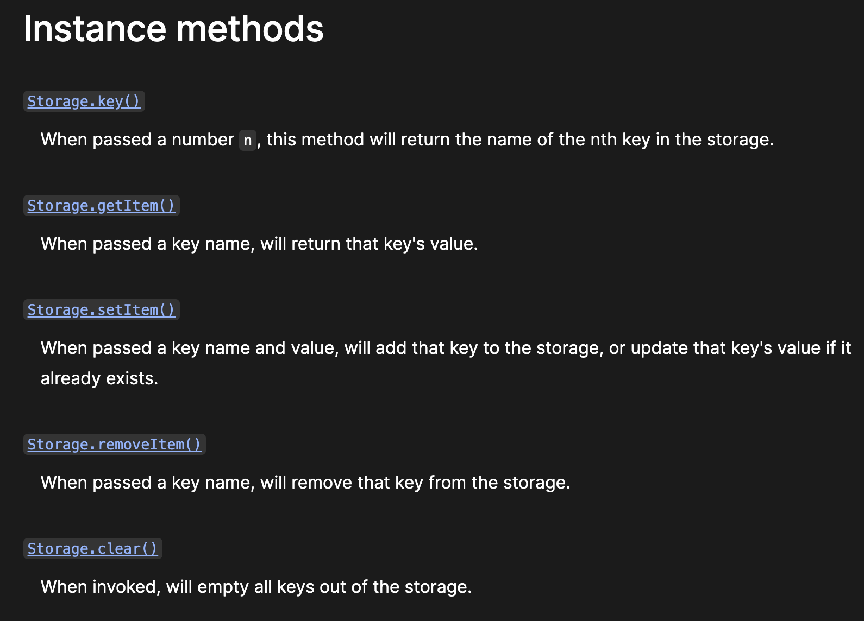

Slide 5
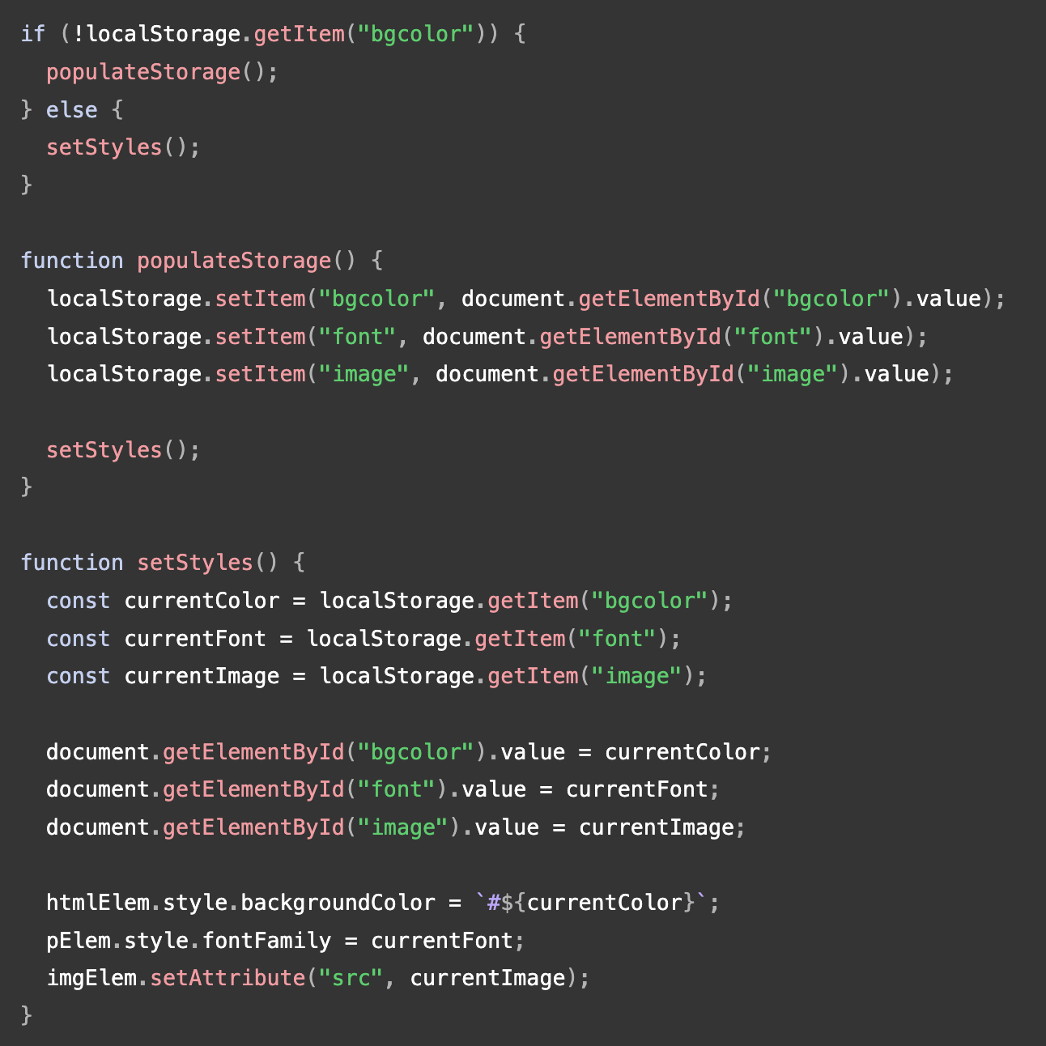
Examples on MDN
Here we access a Storage object by calling localStorage.
We first test whether the local storage contains data items using !localStorage.getItem('bgcolor’).
If it does, we run a function called setStyles() that grabs the data items using Storage.getItem() and uses those values to update page styles.
If it doesn't, we run another function, populateStorage(), which uses Storage.setItem() to set the item values, then runs setStyles().

Slide 6
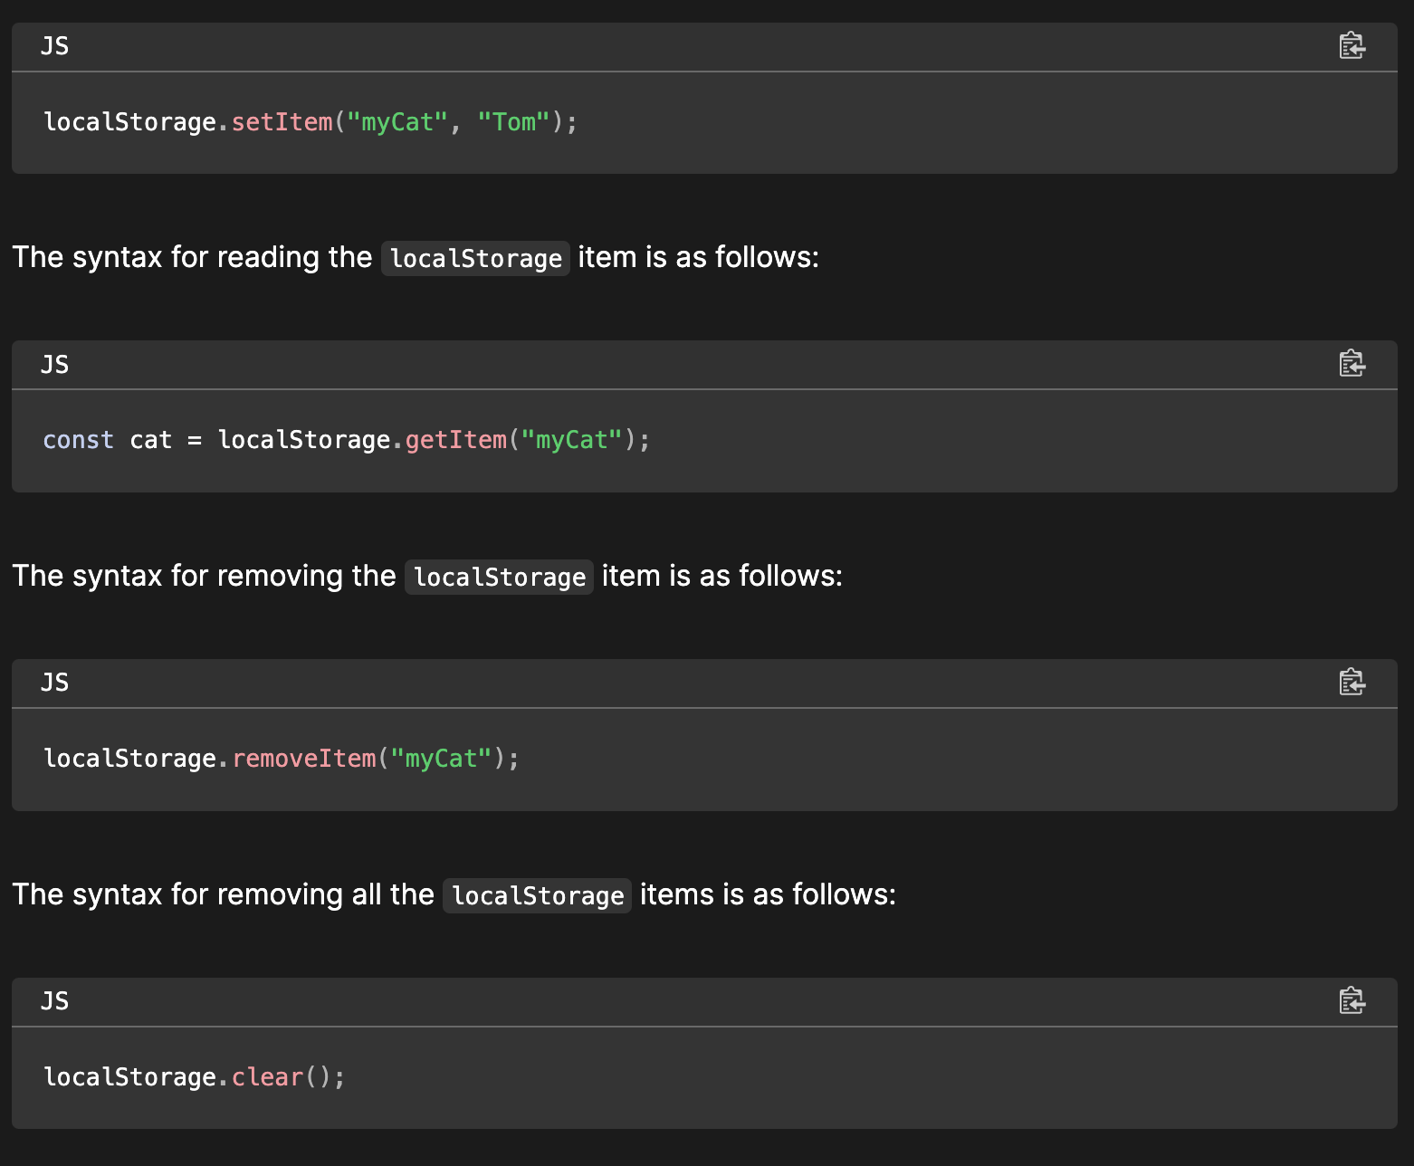
Examples on MDN

Slide 7
localStorage
localStorage is a key/value store of strings
It is important that both the keys and values are recognised as strings
There is an implicit call to “toString” if you give it a non string value
It survives page refreshes and navigation away
It is specific to the domain e.g. google.com, linkedin.com etc
You cannot access localStorage from another domain
It is not secure and can be edited on the fly in the browser
localStorage.setItem('isReal', true);
console.log(typeof localStorage.getItem('isReal')); // string
console.log(typeof localStorage.getItem('isReal') === true); // false
console.log(typeof localStorage.getItem('isReal') === 'true'); // true

Slide 8
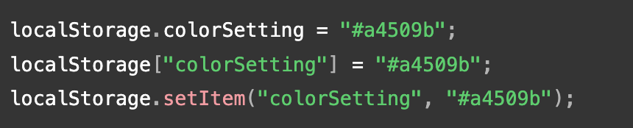
Web Storage API
Storage objects (such as localStorage) are simple key-value stores, similar to objects, but they stay intact through page loads.
The keys and the values are always strings (note that, as with objects, integer keys will be automatically converted to strings).
You can access these values like an object, or with the Storage.getItem() and Storage.setItem() methods.
It's recommended to use the Web Storage API (setItem, getItem, removeItem, key, length) to prevent the pitfalls associated with using plain objects as key-value stores.
These three lines all set the (same) colorSetting entry:

Slide 9
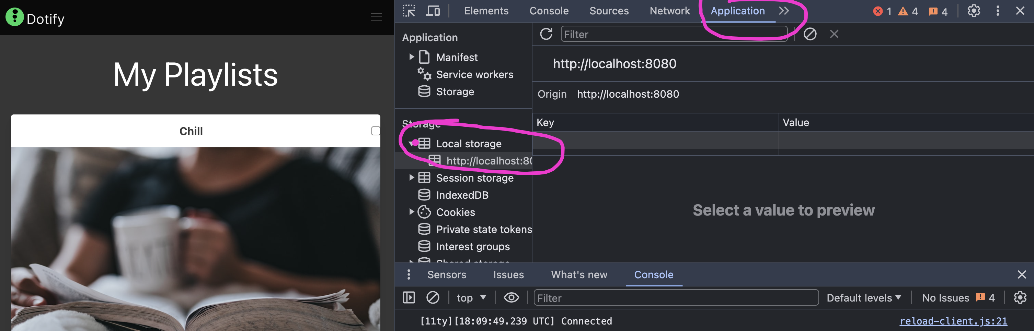
Using localStorage in the Browser

Slide 10
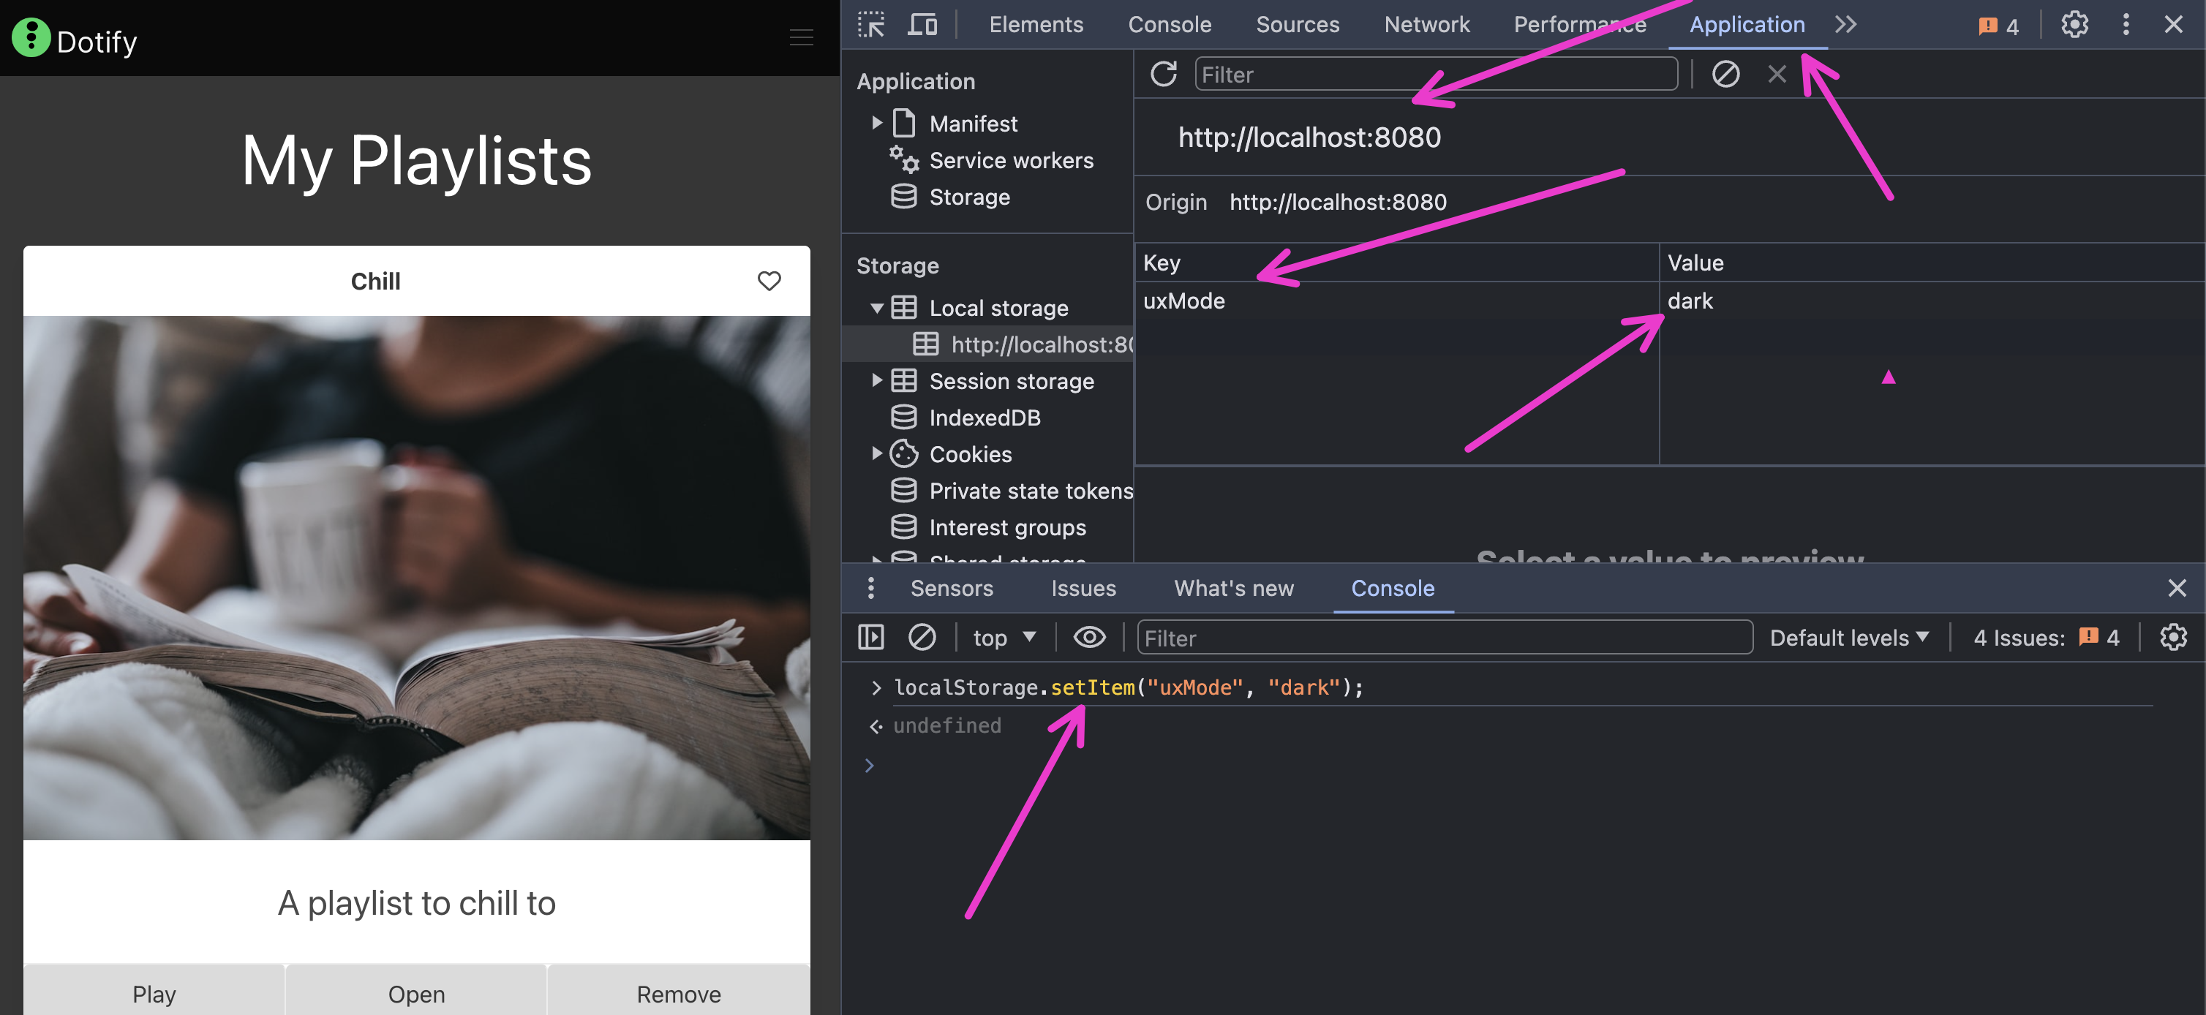

Slide 11
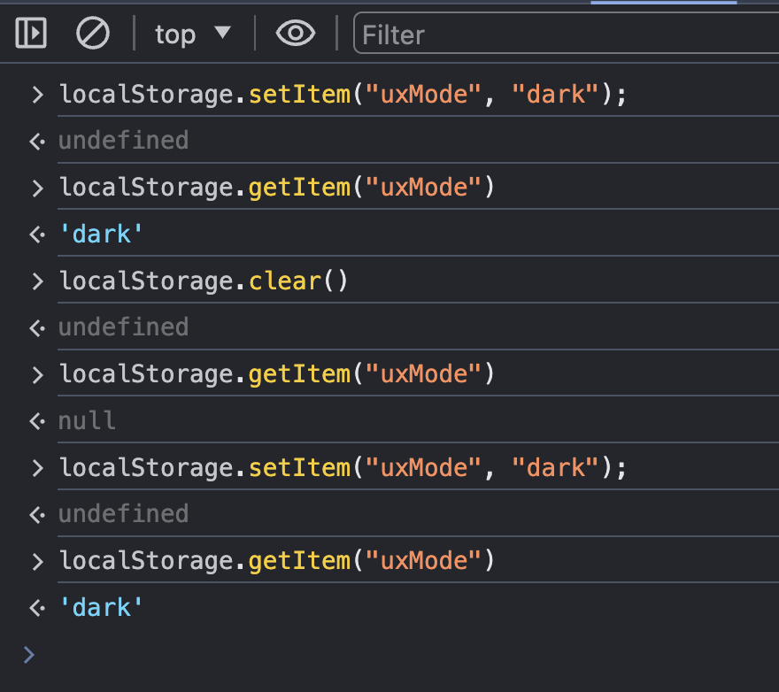

Slide 12
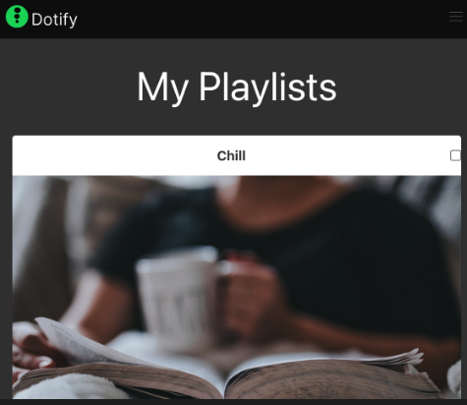
Save an item to localStorage
<header class="card-header">
<p class="card-header-title is-centered">
${playlist.name}
</p>
<input type="checkbox" id="fave-${playlist.name}" class="checkbox"/>
</header>
document.querySelectorAll("[id^=fave-]").forEach(checkbox => {
checkbox.addEventListener('click', (event) => {
const playlistName = event.target.id.replace('fave-','');
const isFavourite = event.target.checked;
localStorage.setItem(playlistName, isFavourite);
})
});

Slide 13
Reading an item to localStorage
<header class="card-header">
<p class="card-header-title is-centered">
${playlist.name}
</p>
<input type="checkbox" id="fave-${playlist.name}" class="checkbox"/>
</header>
document.querySelectorAll("[id^=fave-]").forEach(checkbox => {
const playlistName = checkbox.id.replace('fave-','');
const isFavourite = localStorage.getItem(playlistName);
console.log(`${playlistName} - is fave - ${isFavourite}`);
});

Slide 14
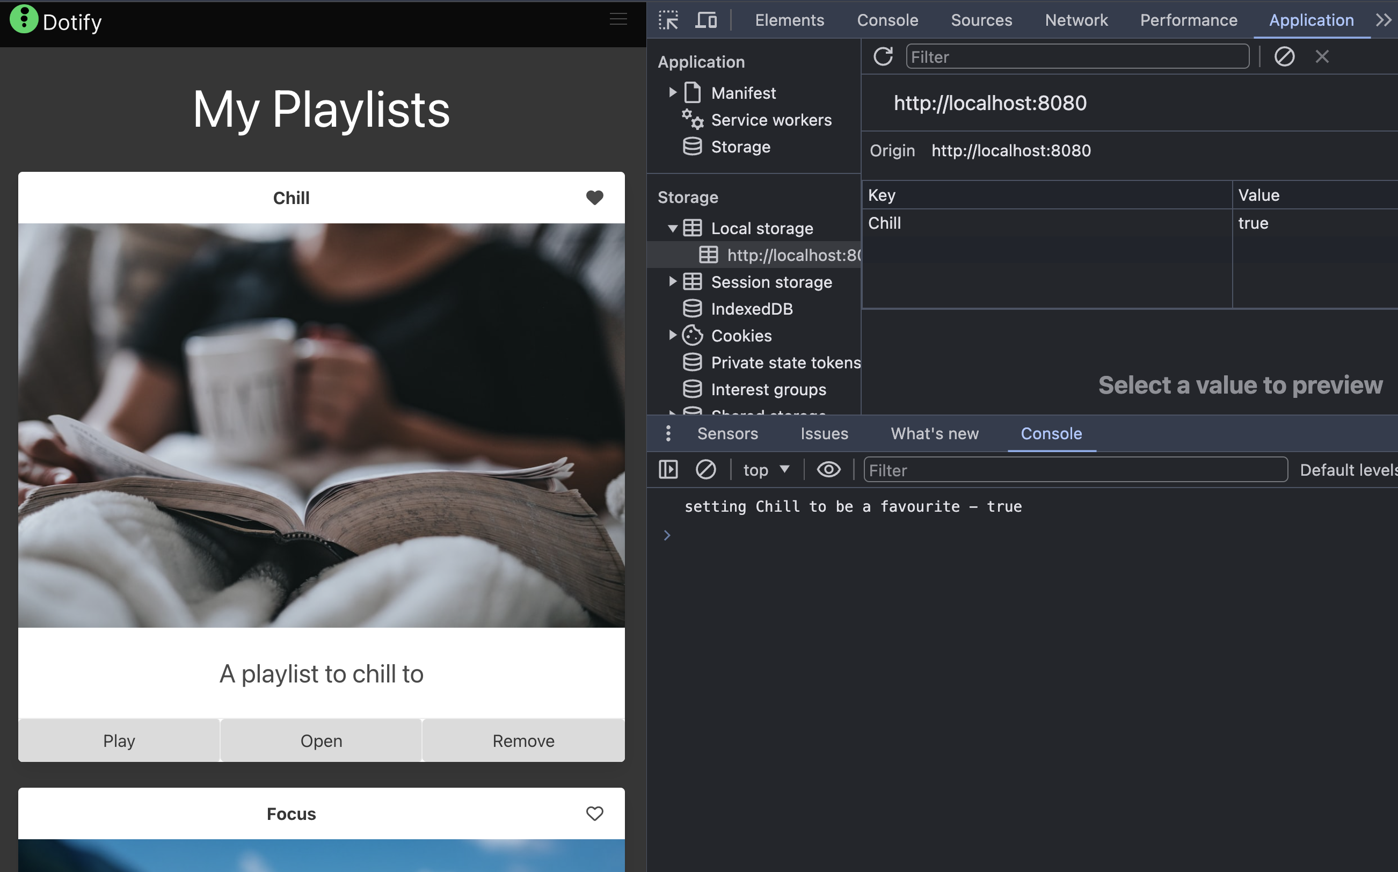

Slide 15
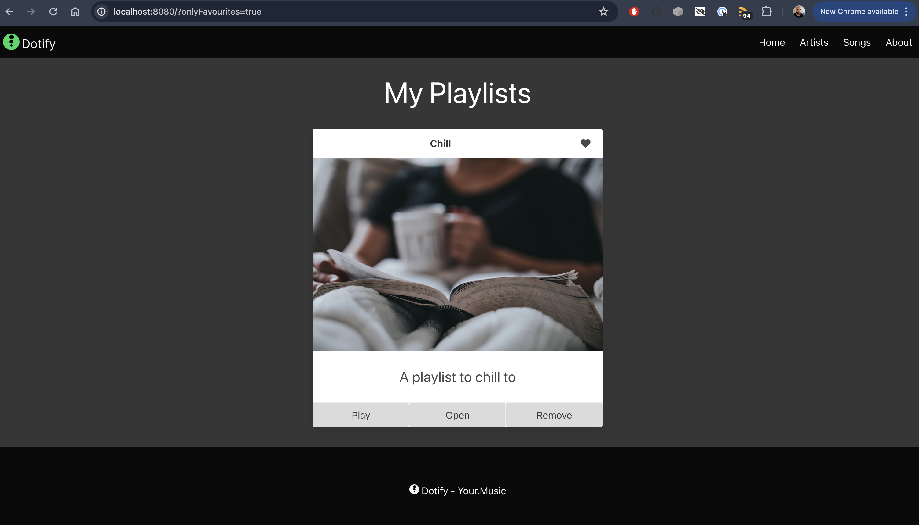
Or you could make a favourites only page
const onlyFavourites = urlParams.get('onlyFavourites') === 'true’;
dotify.dataStore.list().forEach((playlist) => {
if(onlyFavourites) {
const isFavourite = localStorage.getItem(playlist.name) === 'true';
if(isFavourite) {
main.innerHTML = main.innerHTML + dotify.components.createPlaylistItem(playlist);
}
} else {
main.innerHTML = main.innerHTML + dotify.components.createPlaylistItem(playlist);
}
});

Slide 16
Lab Preview

